Slide 1

Annual Meeting
January 16, 2016

Slide 2
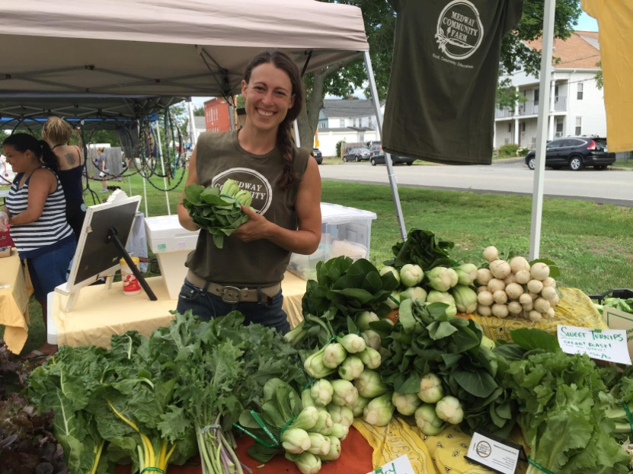
Agenda
Highlights of the Season -- Julia Chase
Annual Report Song & Statistics – Kate Hanson
Election of Board of Directors & Officers
Ideas for 2016
Brainstorming

Slide 3
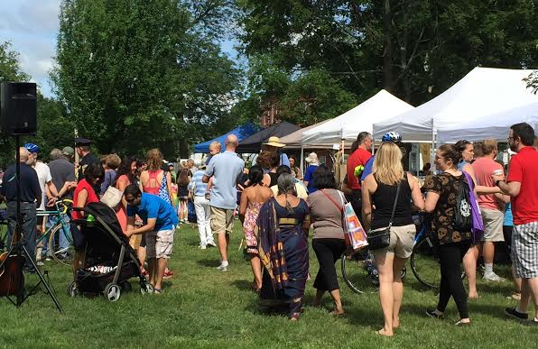
Highlights of the Season:
Strong Growth
Attendance grew by almost 35%.

Slide 4
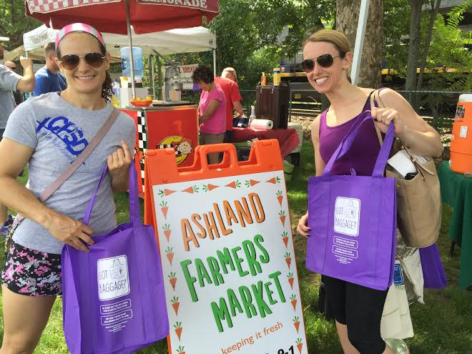
Highlights of the Season:
Got Baggage Initiative
Eliminated plastic bags from the market
Provided BioBags to produce, fish and meat vendors
Reusable shopping bags were provided by some of our sponsors

Slide 5
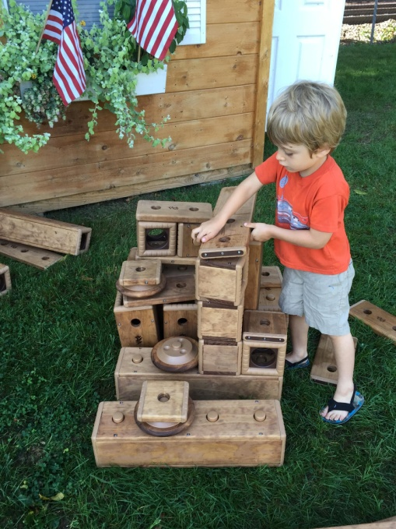
Highlights of the Season:
Outlast Block Set
Successfully crowd funded a wooden block set and storage bench
Thanks to 40 generous contributors!

Slide 6
Highlights of the Season:
Education
AHH gave mini-grants of $860 to the Ashland MS Library and $140 to the Ashland Library
Underwrote a classroom program by the Mass Horticulture Society at the Mindess School
Continued to sponsor the Friends of the Ashland Public Library Documentary Film and Discussions Series on Health & Nutrition.
Notes:
.

Slide 7
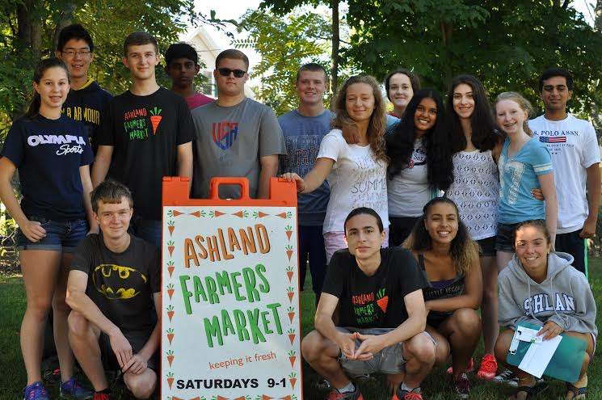
Highlights of the Season:
Student Volunteers
The success of the AFM relies on the volunteer spirit & people power of its all-volunteer staff.
Thanks to teen coordinator Eric Brooks who created a team of 46 HS volunteers this year.
.

Slide 8
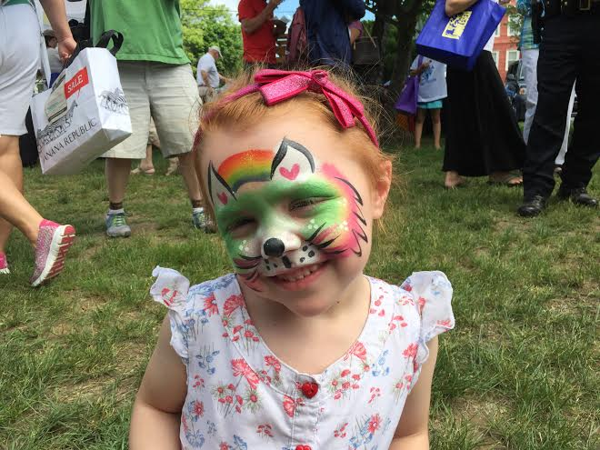
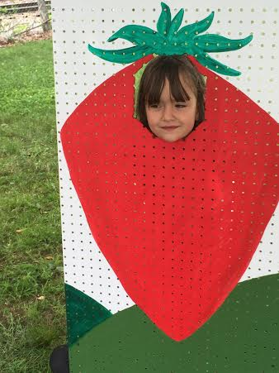
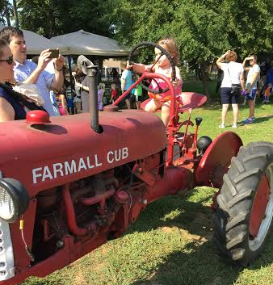
Highlights of the Season:
New Events
Strawberry Festival
July 4th BBQ
Farm Day
Wine and Cheese Fest

Slide 9
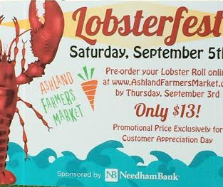
Highlights of the Season:
First Platinum Sponsor
Our new neighbor Needham Bank sponsored the Lobster Fest
NB will still donate $100 to the AFM for each new checking account

Slide 10
Highlights of the Season:
Seven New Vendors
Five Loaves Bakery
The Galley Ice Cream
Valicenti Organico
Mycoterra Farm
SA’s Homestyle
Amir’s Natural Food
Aaronap Wine Cellars
.

Slide 11
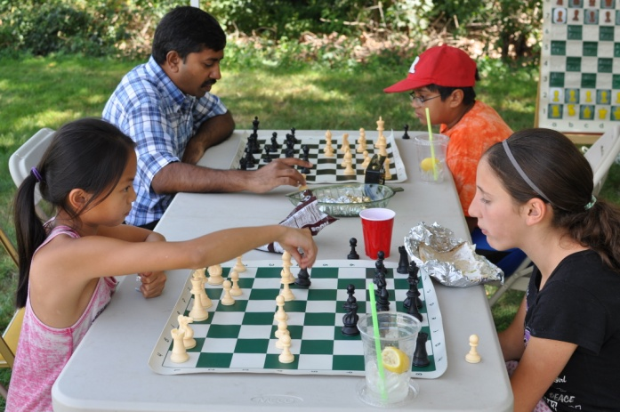
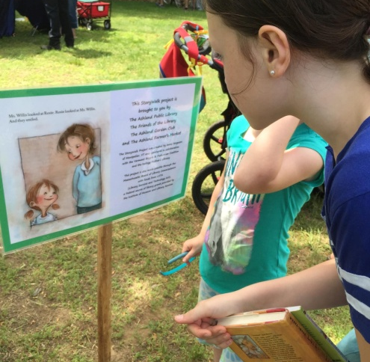
Highlights of the Season:
Connecting with Community
Provided STEAM activities in conjunction with the Ashland Library
Offered the Chess Corner
AFM joined Ashland Day
.

Slide 12
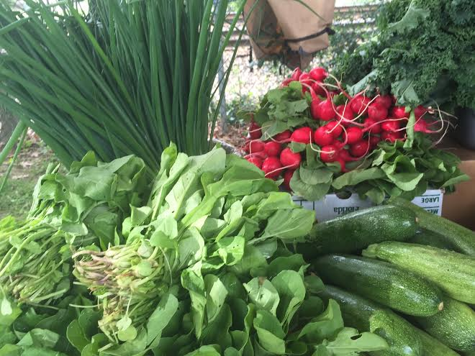
Highlights of the Season:
Ashland Food Pantry
Volunteers streamlined the process of delivering fresh produce to the food pantry
Farmers donated many containers weekly

Slide 13
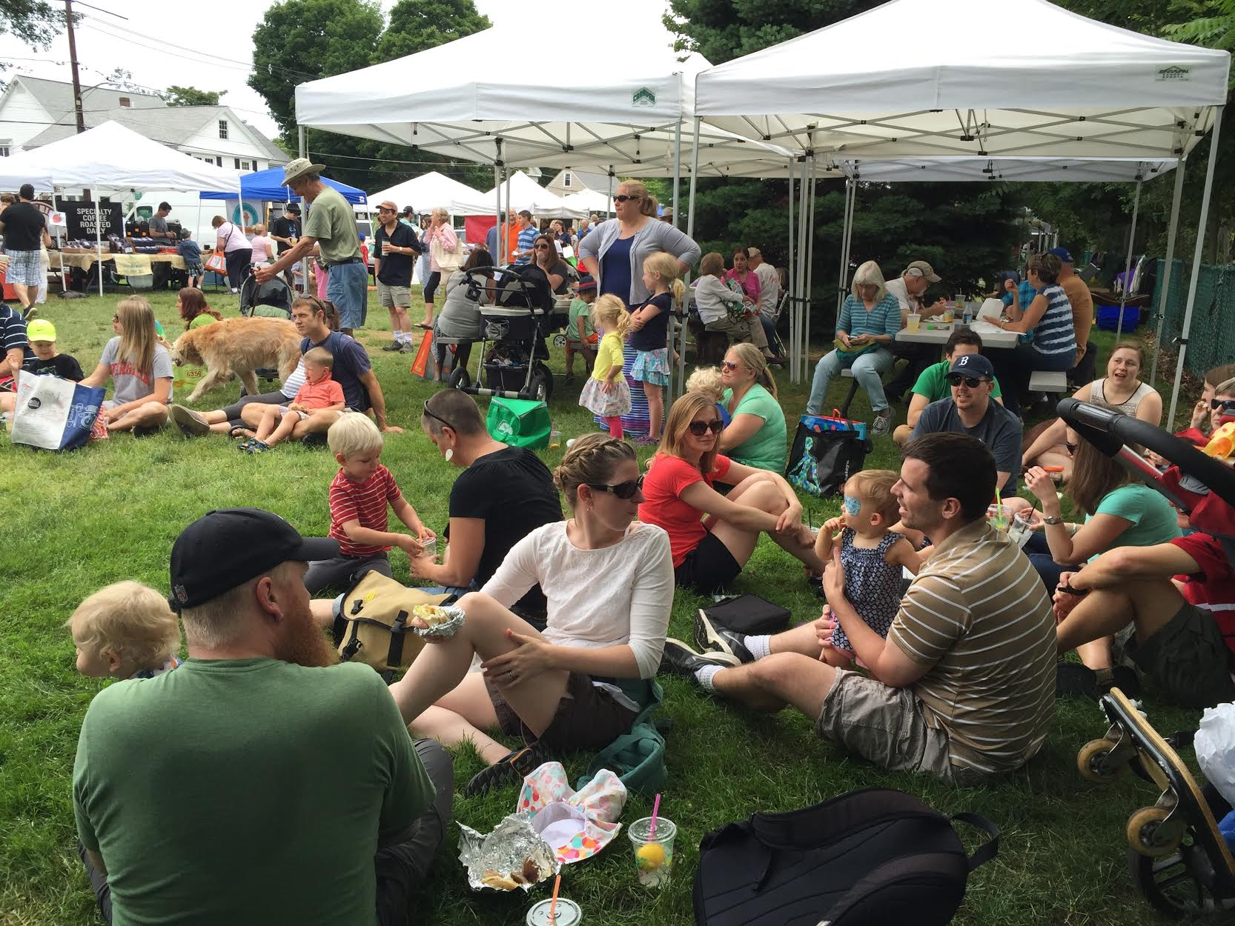
Annual Report
Here is our Annual Song thanks to the talent of Kate Hanson!!

Slide 14
Ashland is my town, Ashland is your town
One thing was missing, a farmers’ market
Working together we made that ha-ap-pen
Ashland‘s the town for you and me
In twenty-fifteen, our market has grown
Thir-ty-five per-cent and getting stronger
Thanks to the town folk, who came out we-ek-ly
Ashland’s the town for you and me
Chorus
Food vendors increased and crafters made more
and many sold out, before the bell tolled
on special fest days, lobsters and straw-ber-ries
Ashland’s the town for you and me

Slide 15
Ashland is my town, Ashland is your town
One thing was missing, a farmers’ market
Working together we made that ha-ap-pen
Ashland‘s the town for you and me
More students volunteered, new music filled the air
All gen-er-ations enjoyed the atmosphere
Wholesome activities, filled summer’s Sat-ur-days
Ashland’s the town for you and me
Chorus
For twenty sixteen, we have new ideas
To help our market, be even better
We hope you’ll be there and bring your dog-friends too.
Ashland’s the town for you and me

Slide 16
2015 Statistics
Average number of customers for 2015: 1,350 (35% more than 2014)
37 food vendors and 27 artisan vendors
18 Sponsors
64 local businesses & organizations showcased as guests
33 adult volunteers and 46 students volunteers
12 event days, 17 different music groups
$1,540 SNAP benefits matched (34% more than 2014)
48 = Most number of tents on one day (Dog Day)

Slide 17
AHH Board of Directors
Guides the direction of the AFM & manages the budget
  Pres - Julia Chase Directors: --
  VP - Steve Mitchell Matt Marshquist
  Treas - Rob Moolenbeek Florence Seidell
  Clerk - Kelly Vaast Eric Brooks
  Jeanne Walker
John Booth

Slide 18
2015 Finances Summary
2015 Starting Balance $6,455
2015 Income $15,986
2015 Expenses $14,300
Cash left over for 2016 $8,144

Slide 19
Ideas for 2016
Make the Ashland Farmers Market a “Trash Free Market”
  The 2016 Ashland Farmers Market is committed to improving on-site waste collection by adding stations for the proper disposal of compost (including biodegradable plastics), recyclable materials and trash
  Award an additional $1000 in minigrants to support this initiative. Grant deadline is March 15

Slide 20
Brainstorming
Let’s identify issues, brainstorm solutions, and
  suggest new ideas.
Notes:
Turn on lights. Use white board. Take notes (2 people).

